Slide 1
Big Data – Definitional Aspects
Lecture – 3

Slide 2
Characteristics of Big data
Gartner’s 3V casted by Douglas Laney in 2001
Volume , Velocity and Variety
IBM’s 4V casted by Zikopoulos
Volume , Velocity , Variety and Veracity
Yuri Demchenko’s 5V
Volume , Velocity , Variety , Veracity and Value
Microsoft’s 6V
Volume , Velocity , Variety , Veracity , Value and Visibility

Slide 3
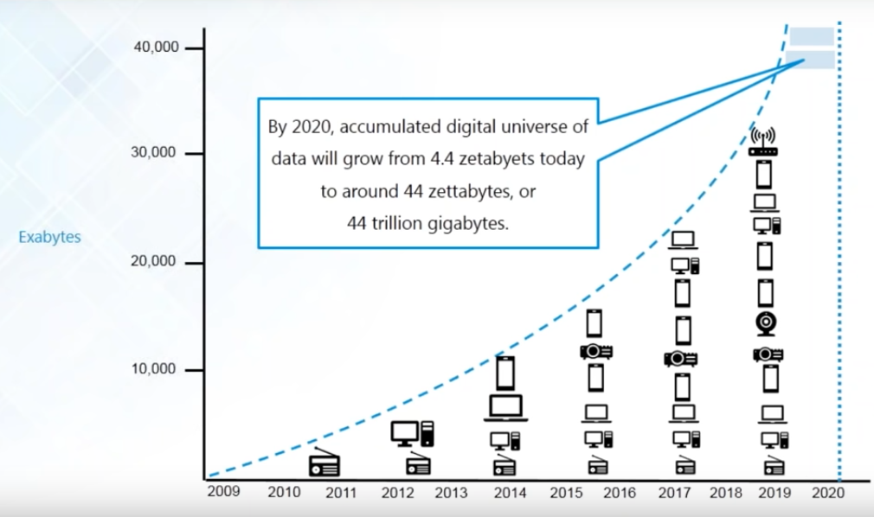
Volume

Slide 4
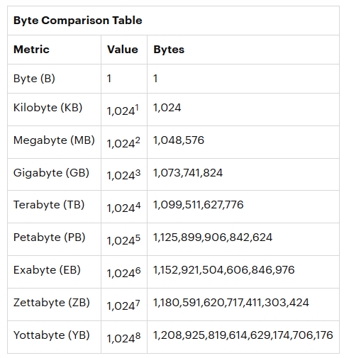

Slide 5
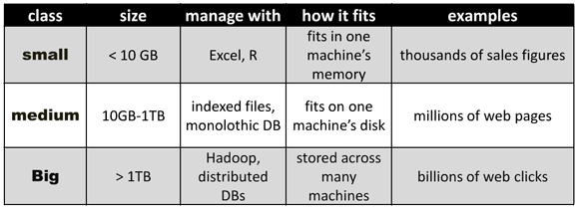

Slide 6
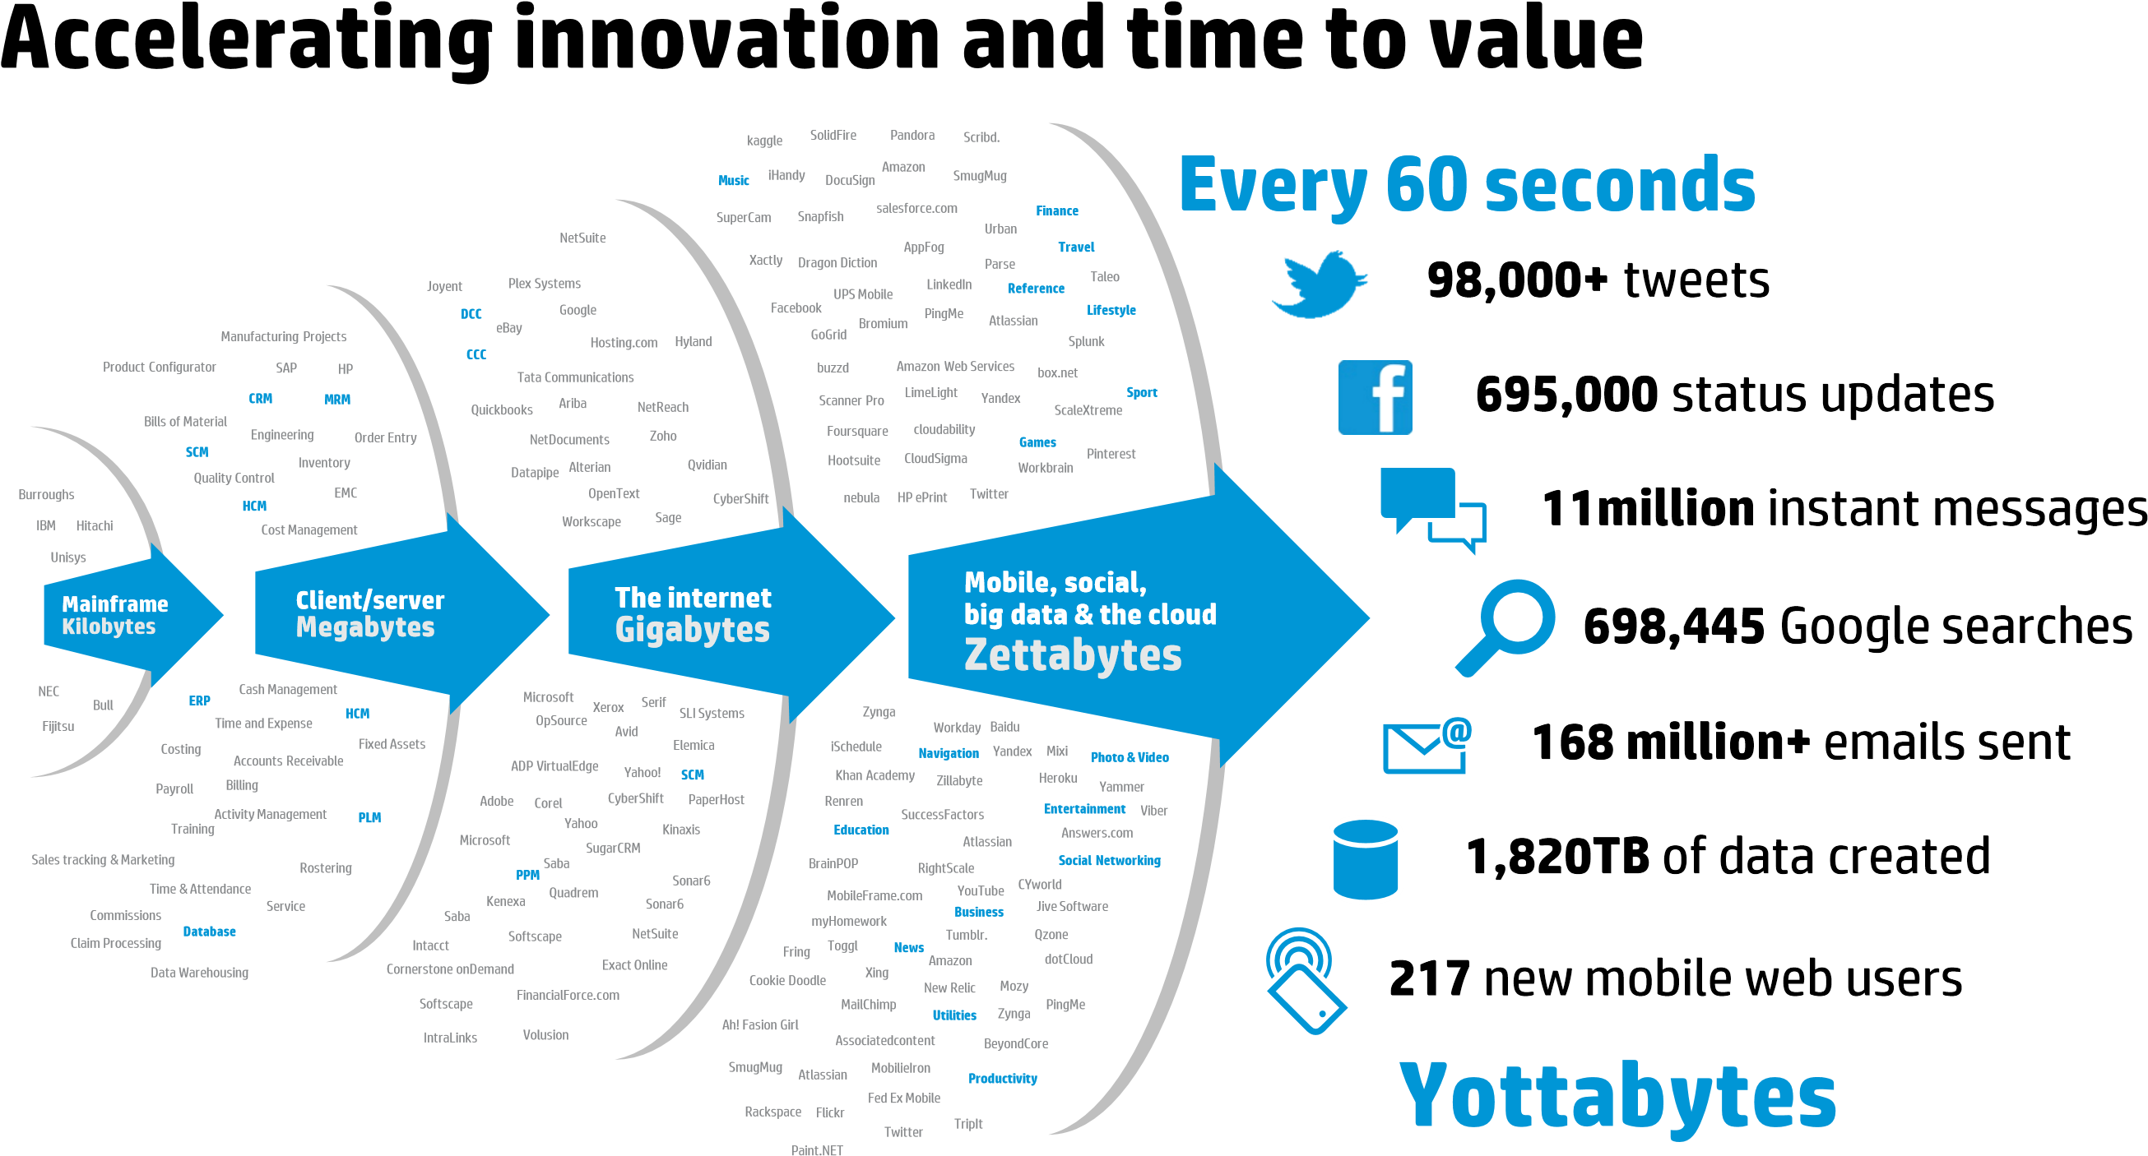
Velocity
Taken from : Hewlett-Packard Development Company “truths and myths about big data”,2013

Slide 7
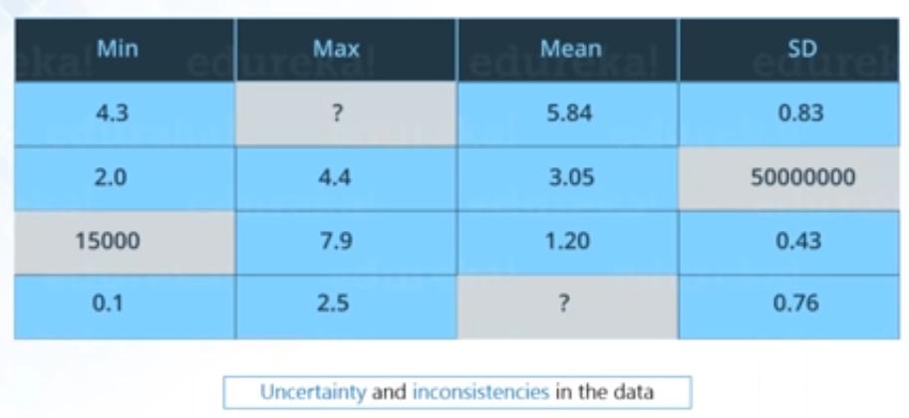
Veracity

Slide 8
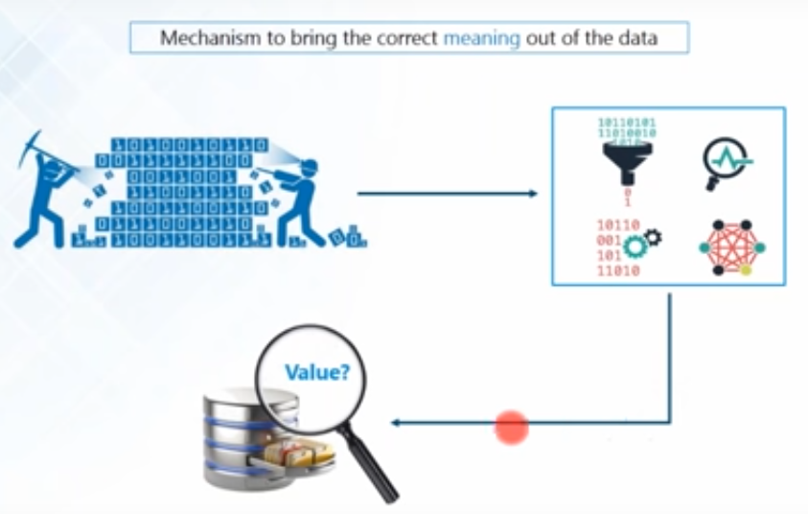
Value

Slide 9
What is big data about?
Answers are often “too big to ….”
Load into memory……..…Store on a hard drive…….…Fit in a standard database
“Fast changing”………..Not just relational
“Digital breadcrumbs” left behind (communication transactions..)—Hard little data particles left behind as people go about their daily lives
Open web data/social media data (facebook, twitter, blogs, online news, videos….)
Remote sensing (satellite, meters…)

Slide 10
What is big data about - and not about?
“Big Data is not about the data” (Gary King)
Institute for social science ,Harvard university
It’s about the analytics—the insights gleaned from the data; and the necessary capacities to do so—human, technological
One step further: it’s about knowledge: getting near to the ‘true’ meaning of a facebook status update;
It’s about sharing and diffusion – visualizations

Slide 11
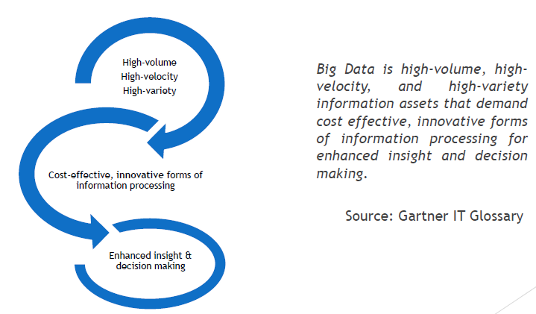
Big data Definition

Slide 12
Challenges with Big data

Slide 13
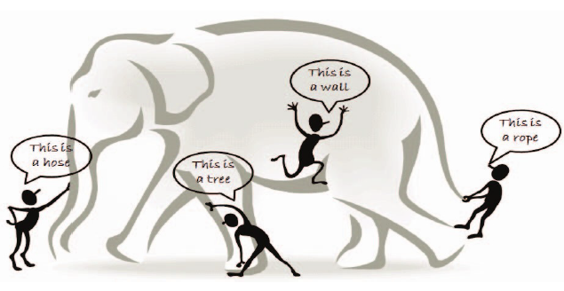

Slide 14
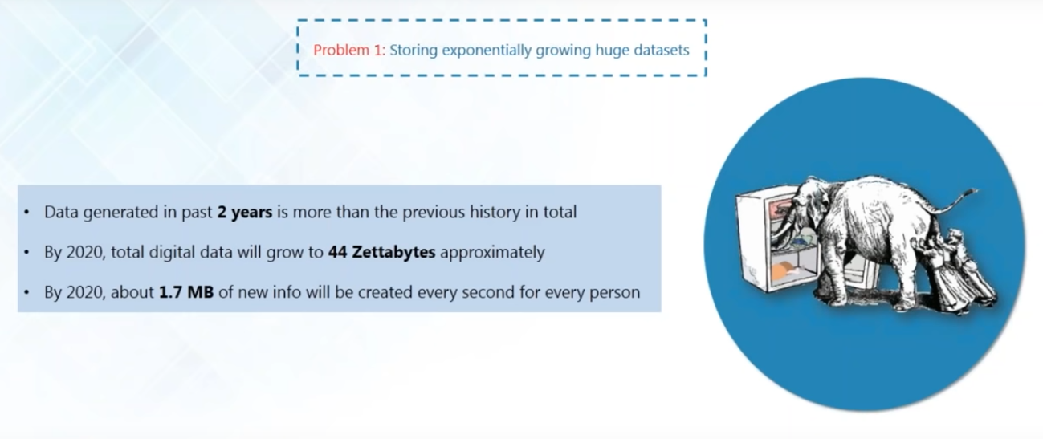

Slide 15
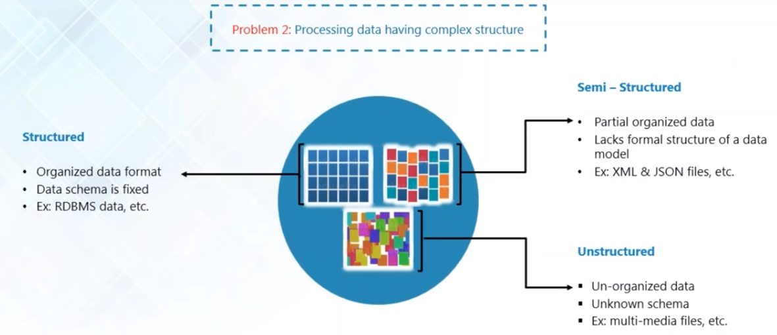

Slide 16
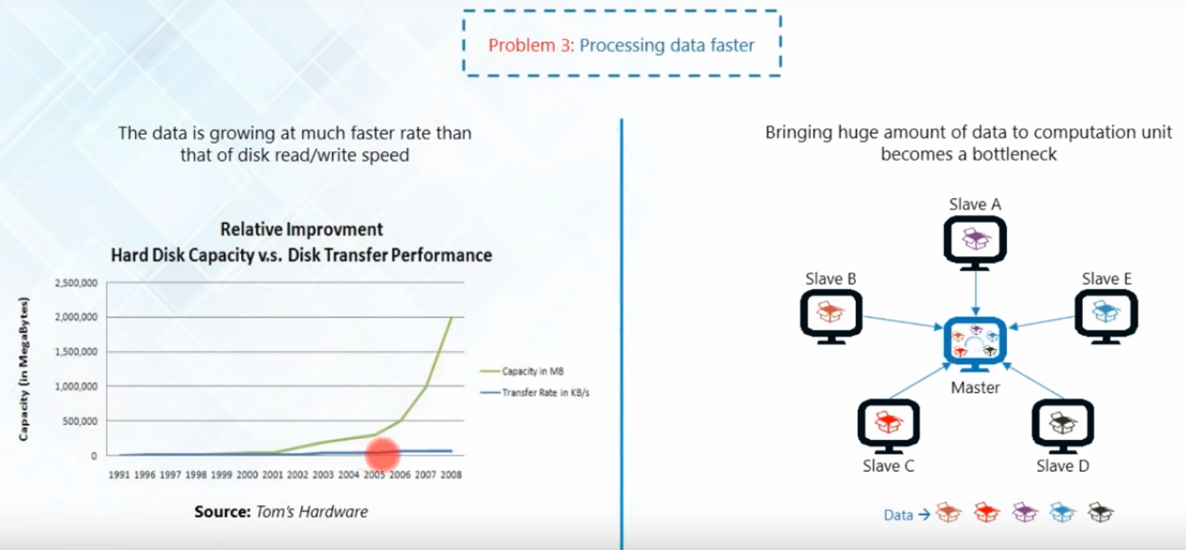

Slide 17
A big data analytics cycle can be described by the following stage −
Business Problem Definition
Data Identification
Data Acquisition & Filtering
Data Extraction
Exploratory Data Analysis
Data Preparation for Modeling and Assessment
Data Visualization
Analysis of Results

Slide 18
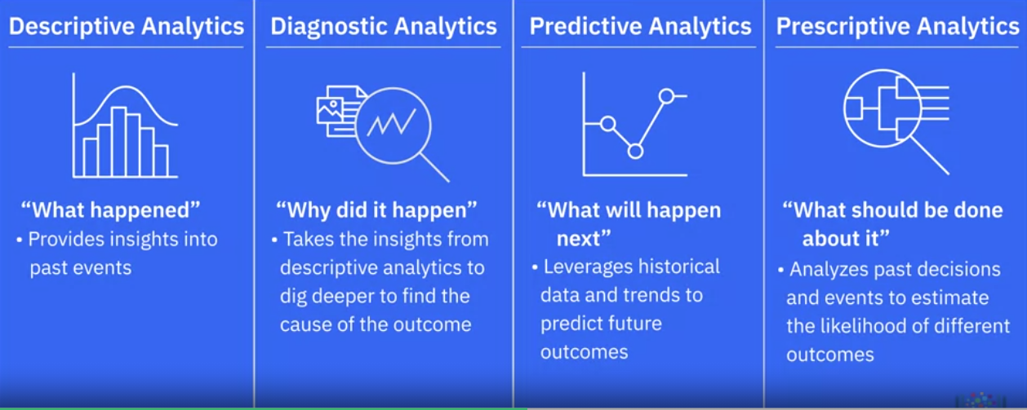
Classification of Data Analytics

Slide 19
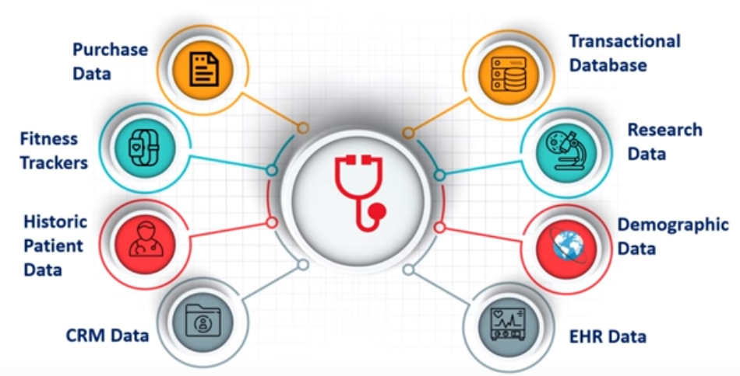
Big data Analytics-Case studies
Healthcare

Slide 20
Traditional Vs Big data Approach
OLTP: Online Transaction Processing
DBMSs
OLAP: Online Analytical Processing
Data Warehousing
RTAP: Real-Time Analytics Processing
Big Data Architecture & Technology

